Slide 1

CAR PRICE PREDICTION THROUGH REGRESSION ANALYSIS
PROJECT BY : KIRAN UK

Slide 2
DATA SCIENCE
LIFECYCLE
1.
PROBLEM STATEMENT
2.
DATA MINING
3.
DATA CLEANING
4.
DATA EXPLORATION
5.
FEATURE
ENGINEERING
6.
PREDICTIVE
MODELLING

Slide 3
PROBLEM STATEMENT
A Chinese automobile company aspires to enter the US market by setting up their manufacturing unit there.
Their aim was to produce cars locally to give competition to their US and European counterparts.
They have contracted an automobile consulting company to understand the factors on which the pricing of
cars depends.
Specifically, they want to understand the factors affecting the pricing of cars in the American market, since those may be very different from the Chinese market.
The company wants to know :
1. Which variables are significant in predicting Price of a Car
2. How well these variables describe Price of a Car

Slide 4
DATA MINING : Attribute Information
ATTRIBUTE | DESCRIPTION
Symboling | Cars are classified from -2(least risky) to +3(most risky)
CarName | Different cars have been listed in this attribute
Fueltype | Categorized based on the fueltype : Gas or Diesel
Aspiration | Whether Standard or Turbocharged
Doornumber | Number of doors the car have: 2 or 4
Carbody | Type of body the Car have
Drivewheel | Whether RWD,FWD,AWD
Enginelocation | Depending on Engine Location : Front or Back
Wheelbase | Length of Wheelbase
Carlength | Length of the Car
Carwidth | Width Of the Car
Carheight | Height of the Car

Slide 5
ATTRIBUTE | DESCRIPTION
Curbweight | Actual Weight of the Car without any external Load
Enginetype | Based on the type of Engine Used
Cylindernumber | Number of cylinders present inside the Engine
Enginesize | Size of the Engine
Fuelsystem | Based on the type of Fuel Injection
Boreratio | Cylinder bore Ratio
Stroke | Stroke length of the cylinder
Compressionratio | Ratio of Compression Volume of the Piston
Horsepower | Engine Power
Peakrpm | Maximum RPM of the Engine
Citympg | City Mileage
Highwaympg | Highway Mileage
Price | Car Price { TARGET VARIABLE }

Slide 6
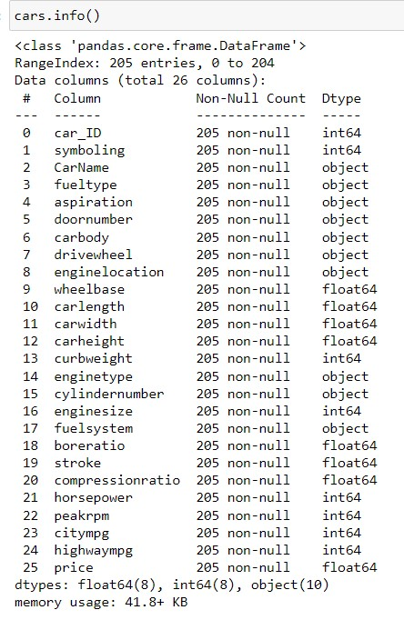
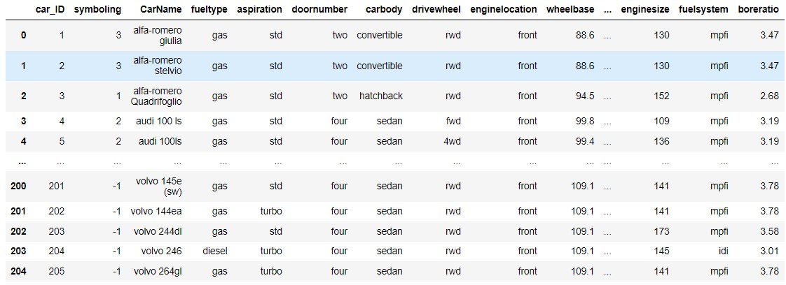
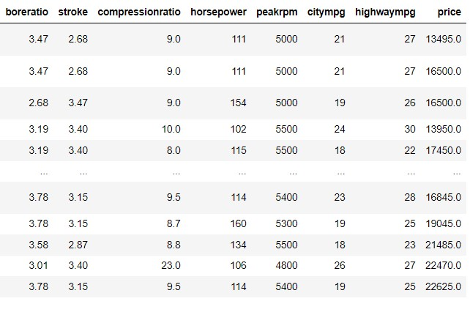
DATA CLEANING

Slide 7
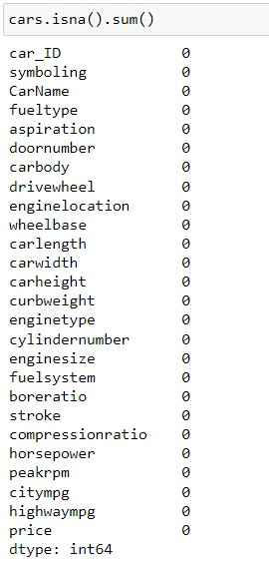
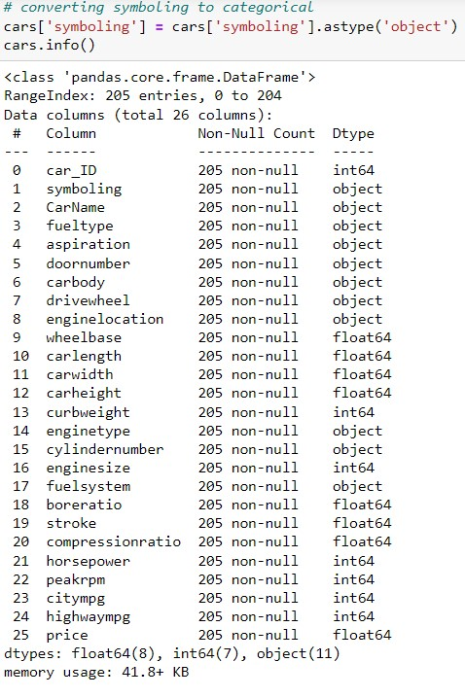
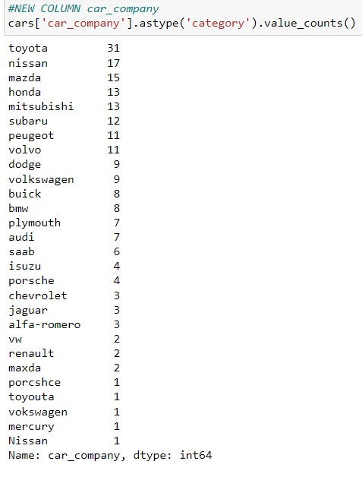

Slide 8
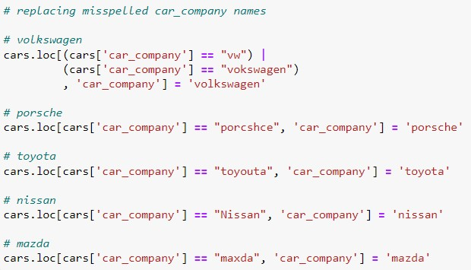
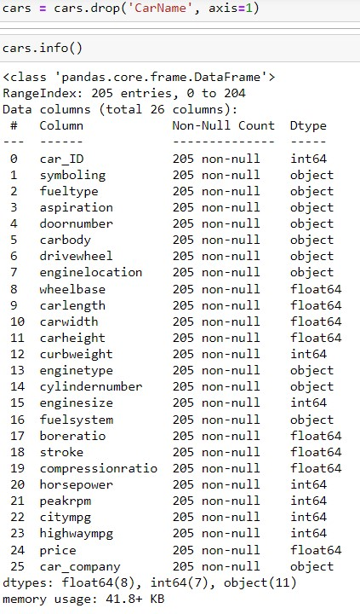
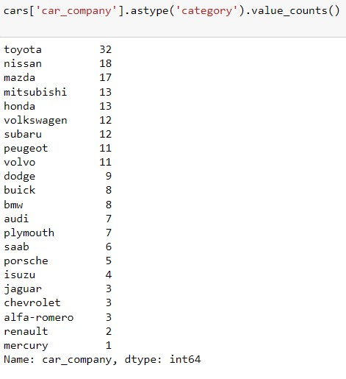

Slide 9
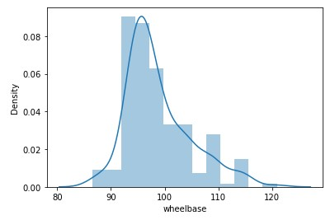
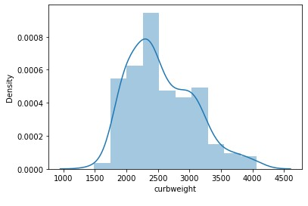
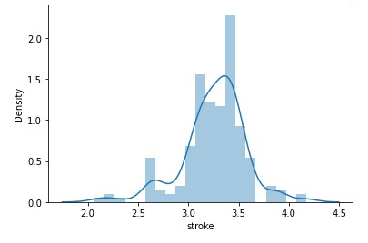
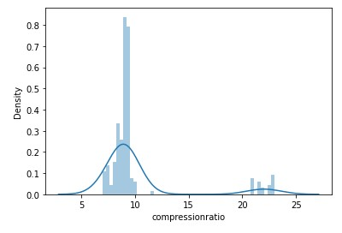
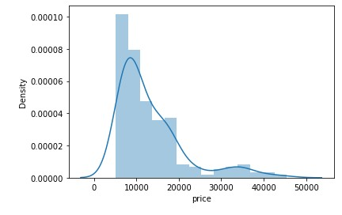
EXPLORATORY DATA ANAYSIS [EDA]
DISTRIBUTION PLOT

Slide 10
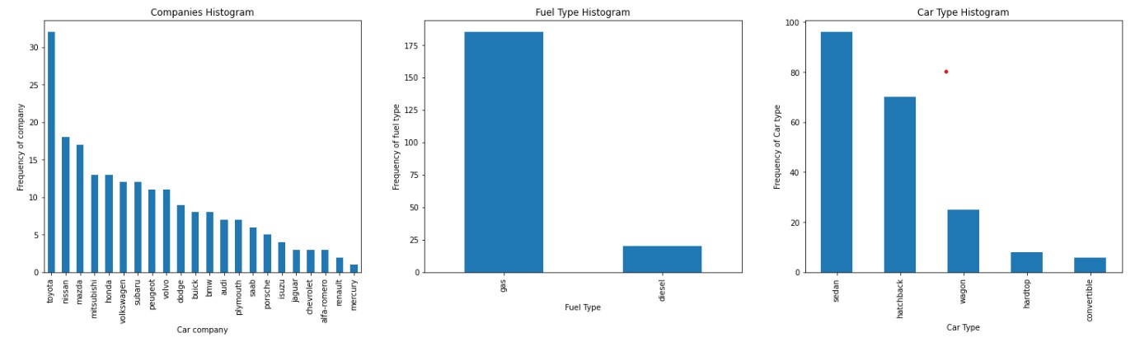
Bar Plot

Slide 11
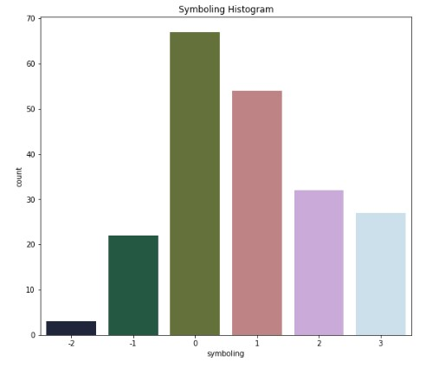
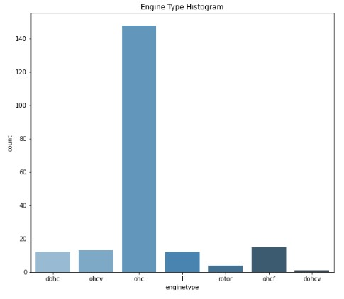
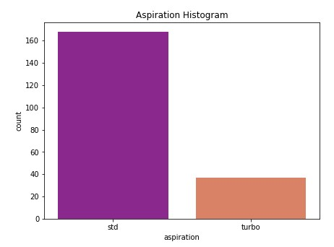
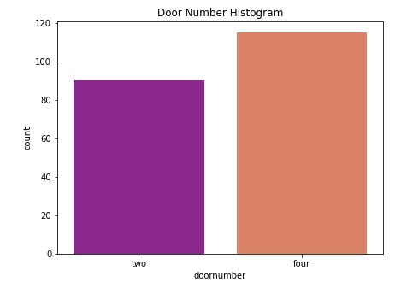
COUNT PLOT

Slide 12
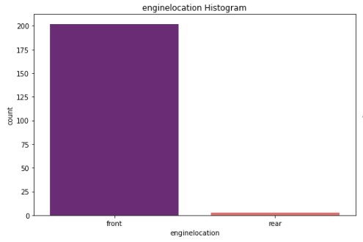
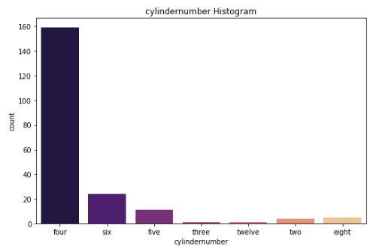
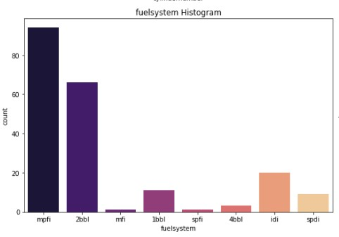
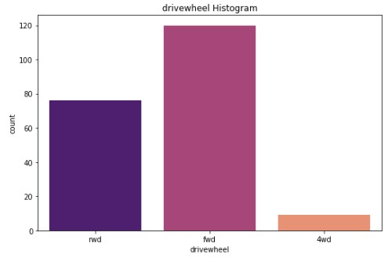

Slide 13
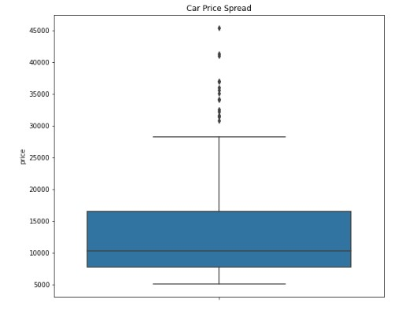
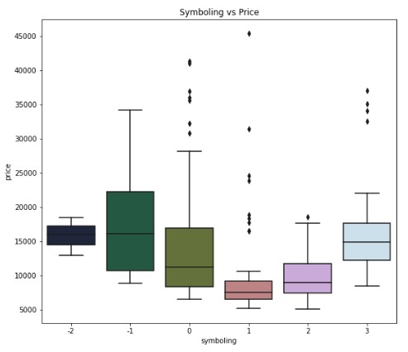
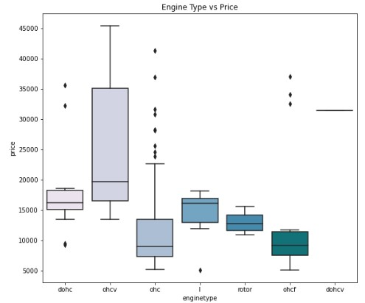
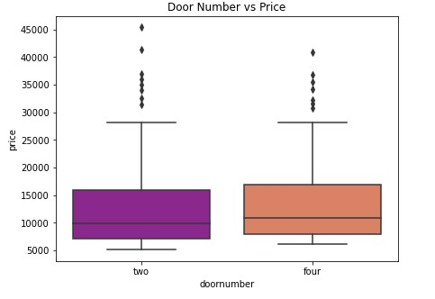
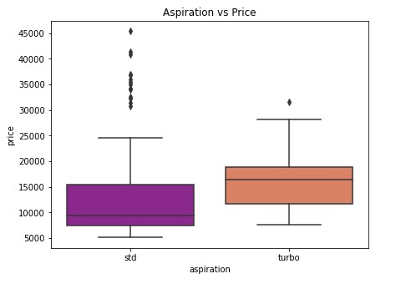
BOX PLOT

Slide 14
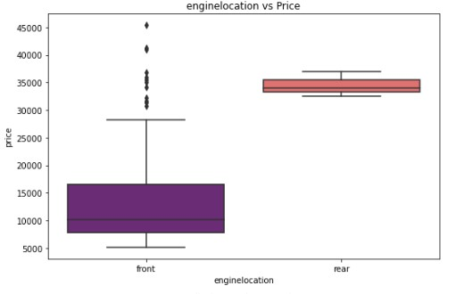
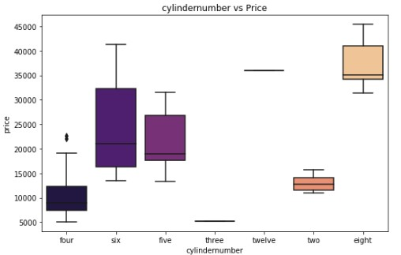
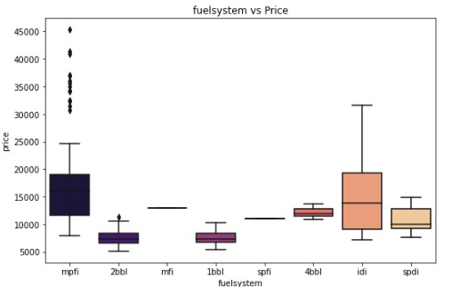
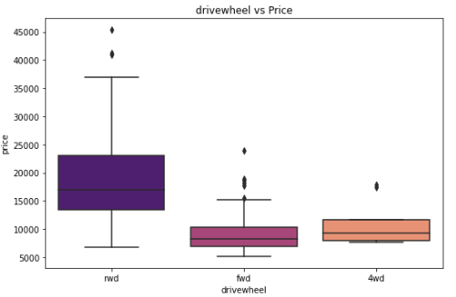

Slide 15
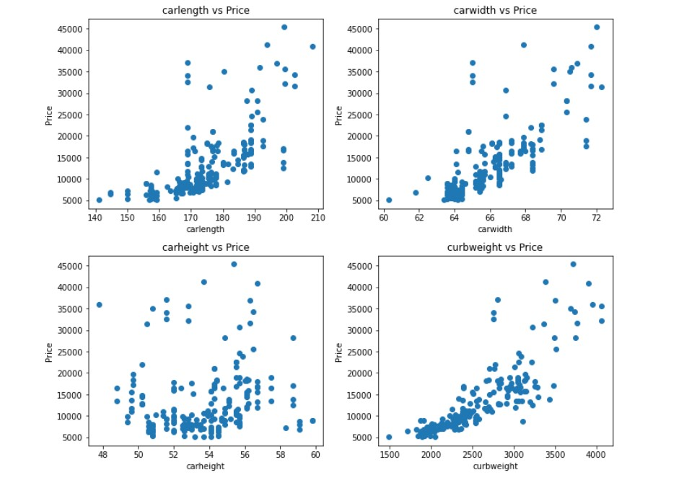
VISUALIZING CONTIONUS DATAS

Slide 16
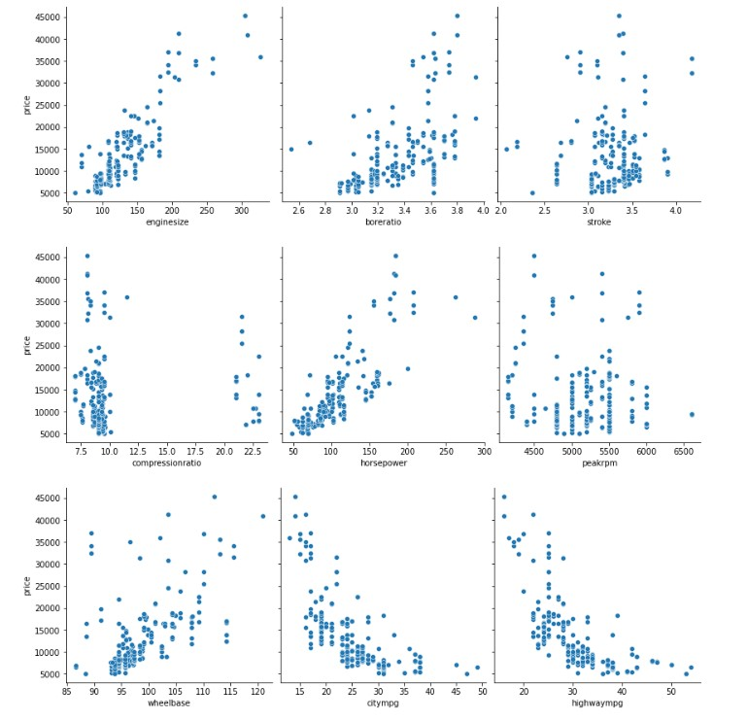

Slide 17
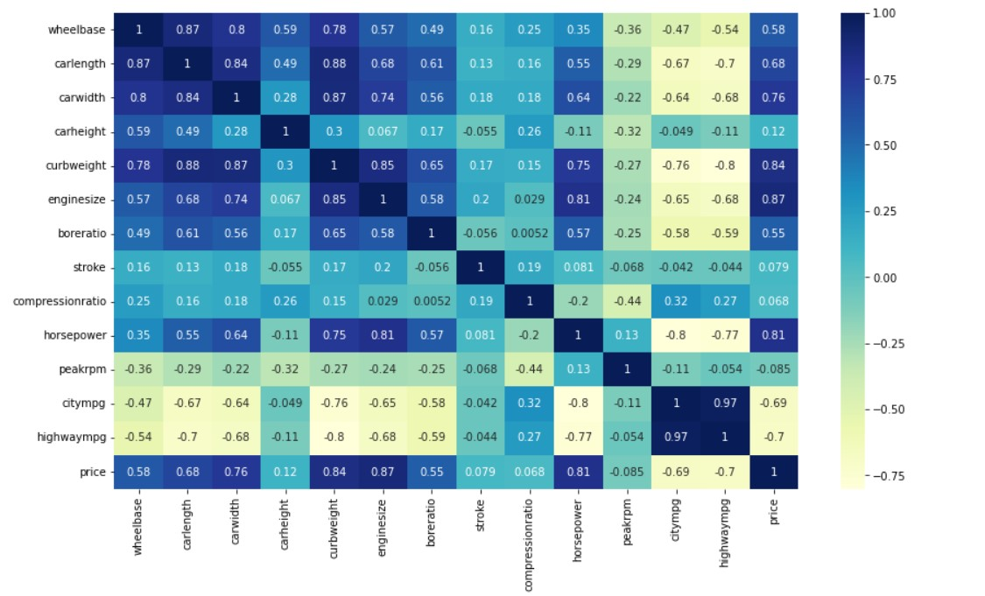
CORRELATION : USING HEAT MAP

Slide 18
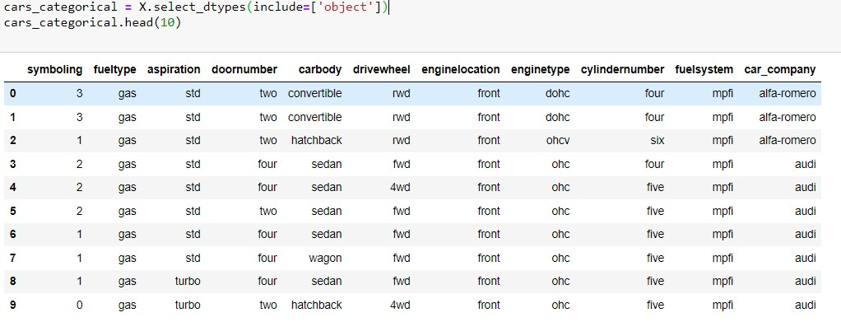
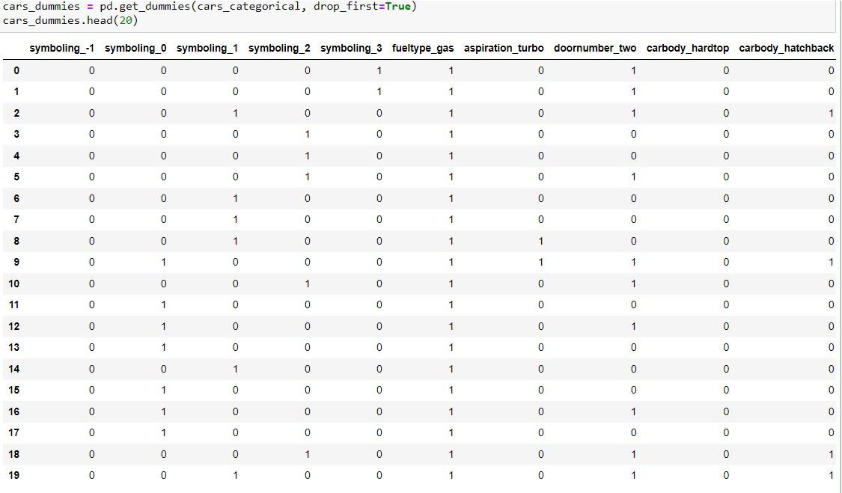
FEATURE ENGINEERING

Slide 19
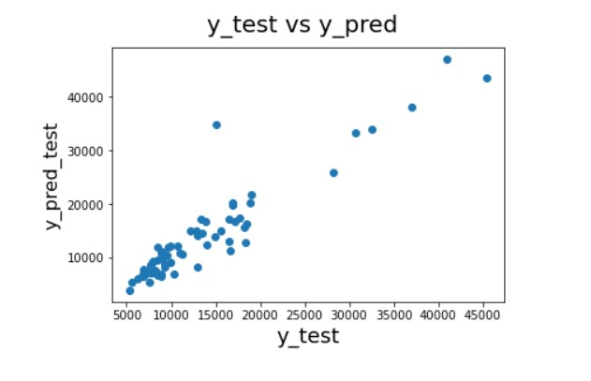
PREDICTIVE MODELLING :REGRESSION ANALYSIS
1. LINEAR REGRESSION MODEL
Library used : sklearn.linear_model [LinearRegression]
Split used for training and testing the data : 70-30
R2 SCORE :
FOR TRAINING SET : 0.9757
FOR TESTING SET : 0.8383

Slide 20
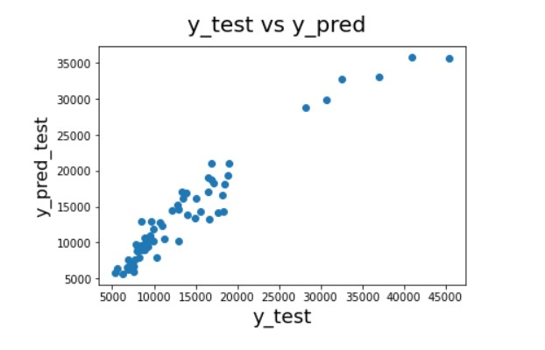
2. RIDGE REGRESSION MODEL
Library used : sklearn.linear_model [Ridge]
Split used for training and testing the data : 70-30
R2 SCORE :
FOR TRAINING SET : 0.9589
FOR TESTING SET : 0.9225

Slide 21
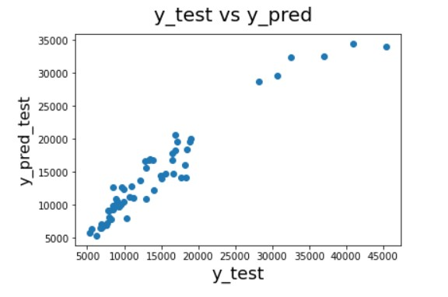
3. LASSO REGRESSION MODEL
Library used : sklearn.linear_model [Lasso]
Split used for training and testing the data : 70-30
R2 SCORE :
FOR TRAINING SET : 0.9465
FOR TESTING SET : 0.9111

Slide 22
CONCLUSION
WHILE COMPARING THE THREE MODELS IT IS CLEARLY EVIDENT THAT THE RIDGE REGRESSION MODEL PERFORMS WELL IN BOTH TRAINING AS WELL AS TESTING SETS WHILE WE COMPARE THE R2 SCORE.
HENCE WE CAN ARRIVE AT THE CONCLUSION THAT RIDGE REGRESSION MODEL IS THE SUITABLE MODEL WE OBTAINED AFTER PERFORMING REGRESSION ANALYSIS

Slide 23
THANK YOU!

